Slide 1


SOFTWARE TESTING PROJECT
A Simple Overview of Testing Concepts & Automation Tools
Ensuring Quality Through Smart Software Testing
Egypt Digital Pioneers Initiative

Slide 2
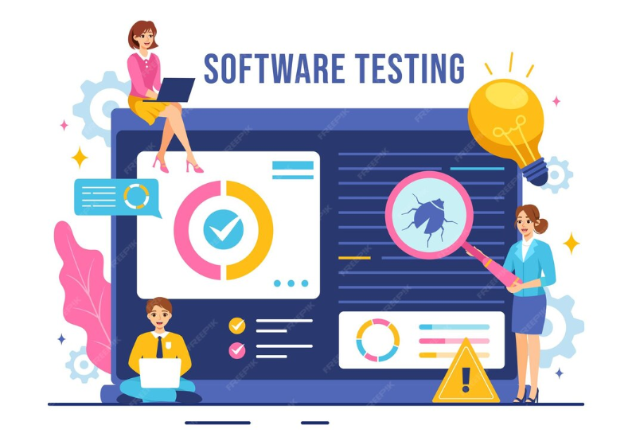

What is Software
Testing
Software testing is a method to check whether the software application matches the requirements and to ensure that the software is bug/defect free.
Importance of Software Testing
Quality and Reliability Shield
Software Testing: Ensuring quality and investing in product success, not just a routine step.
Financial Foresight
UX Ambassador
Strategic Compass
Commitment to Standards
Egypt Digital Pioneers Initiative

Slide 3

Software Testing
Technical Objective – Verification & QC
Objectives
Early detection of defects to reduce costs.
Ensuring the software complies with all requirements and specifications.
Software testing is a strategic tool to ensure quality and boost user confidence
Identifying and correcting errors, supporting product release decisions.
Strategic Objective – Confidence & User Needs
Building trust in product quality and preventing failures
Representing the user’s voice to ensure usability.
Meeting project goals within scope, quality, time, and budget (SQTC)
Egypt Digital Pioneers Initiative

Slide 4












Software Testing Life Cycle (STLC)
Testing is an organized process that follows sequential steps to ensure comprehensive coverage and continuous control. The cycle consists of seven key stages, starting from planning and ending with test closure.
Test Monitoring and Control
Test Design
Test Execution
Test Planning
Test Analysis
Test Implementation
Test Completion
Egypt Digital Pioneers Initiative

Slide 5
Software Testing Methods
Manual Testing
Manual testing relies on the tester’s eyes, logic, and intuition to catch issues machines may miss.
Software testing can be executed using two main methods: manual execution performed by testers, or automated execution performed by tools and scripts to ensure quality and reliability
Automation Testing
Automation testing delivers faster, more reliable results especially for repetitive and large-scale scenarios.
Importance of Software Testing
Testing ensures every feature works as expected,protects the user experience, and builds confidence before real users interact with the system.
Egypt Digital Pioneers Initiative

Slide 6
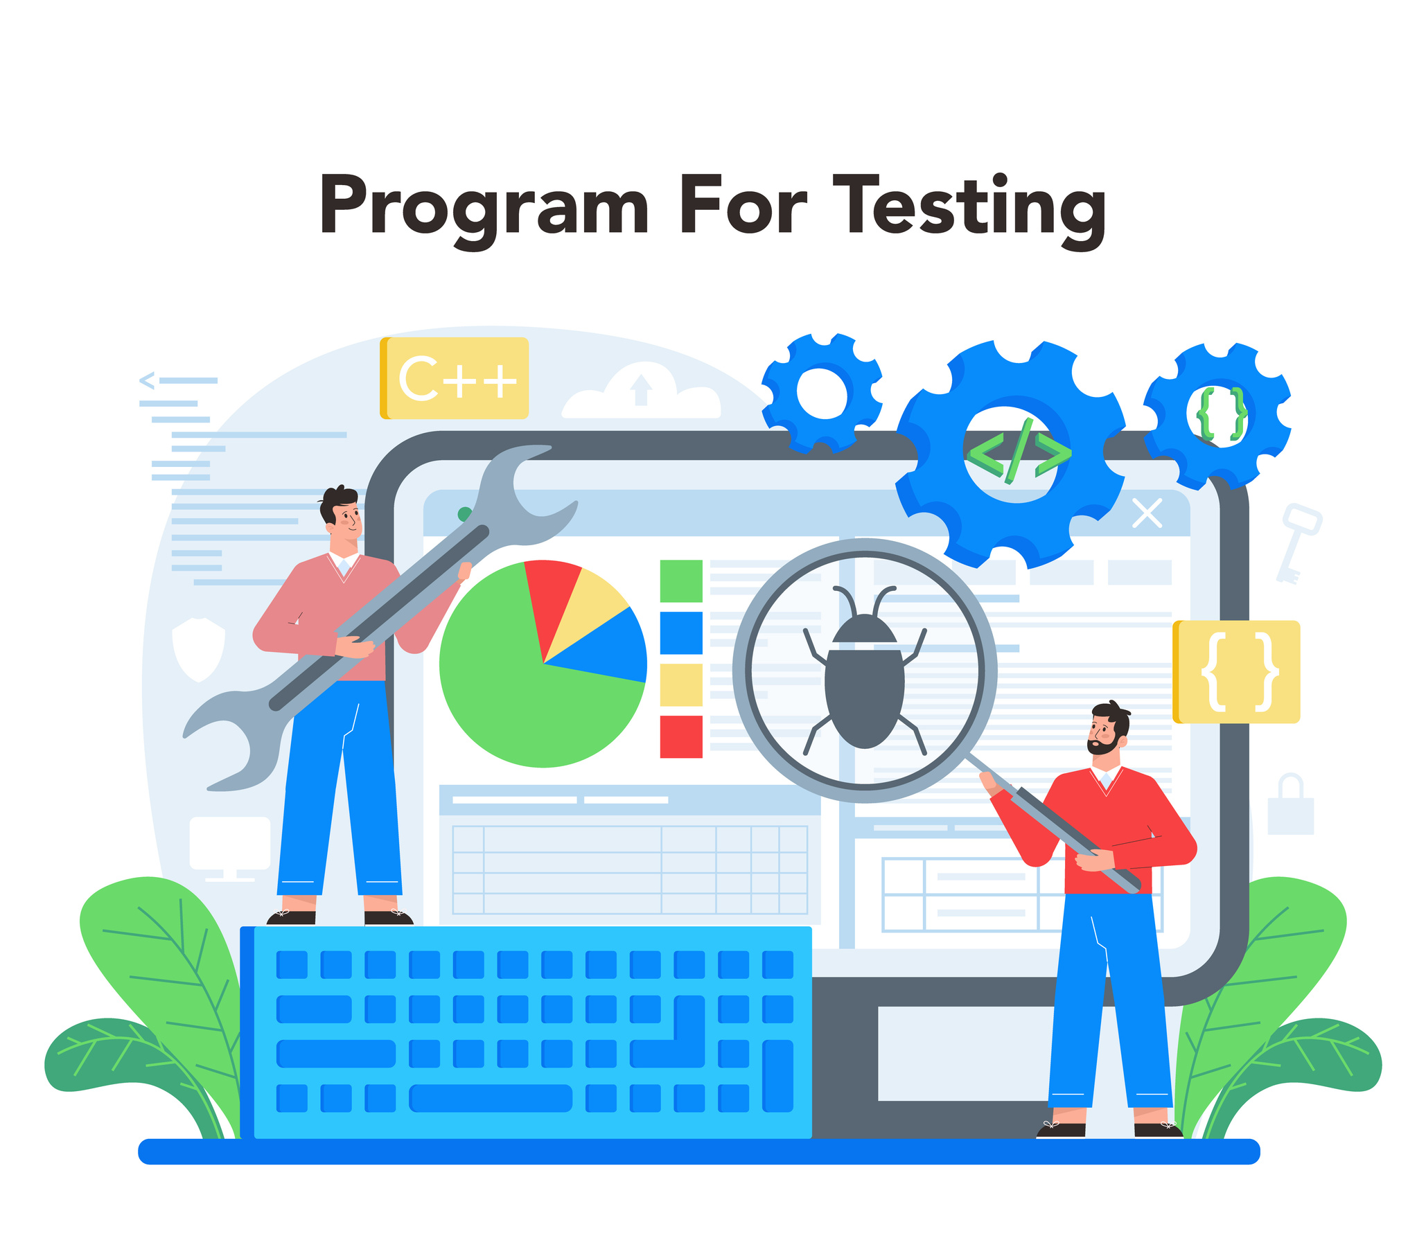
Manual Testing
Advantages of Manual Testing
Manual Testing means the tester checks the system manually without using any automation tools or code, interacting with it just like a real user.
Easy to perform and learn
Best for UI and usability checks
Its goal is to ensure everything works correctly and catch any issues before they reach the end user.
Flexible with changing requirements
Early detection of defects to reduce costs.
Disadvantages of Manual Testing
Time-consuming for repeated tests
Higher chance of human error
Not efficient for large-scale regression
Difficult to maintain consistency across testers
Egypt Digital Pioneers Initiative

Slide 7
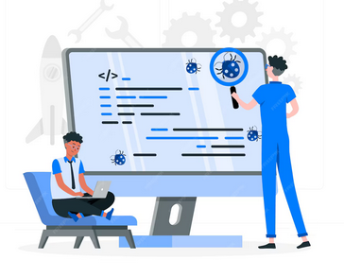
When Do We Use
01
Manual Testing?
New or Changing Features
Manual testing is essential when the feature is new, unstable, or still changing,
because human judgment can quickly adapt to updates and unclear requirements.
Manual testing is used for new or frequently changing features, for evaluating the user experience, and for scenarios that require human judgment to detect issues automation may miss.
02
UI/UX and Visual Checks
Some issues only humans can notice, such as design problems, alignment, layout,
and overall user experience—automation can't reliably evaluate how the interface feels.
03
Complex Scenarios Needing Human Logic
When the behavior is unusual, unclear, or needs intuition and critical thinking,
manual testing is the best approach to understand how real users interact with the system.
Egypt Digital Pioneers Initiative

Slide 8
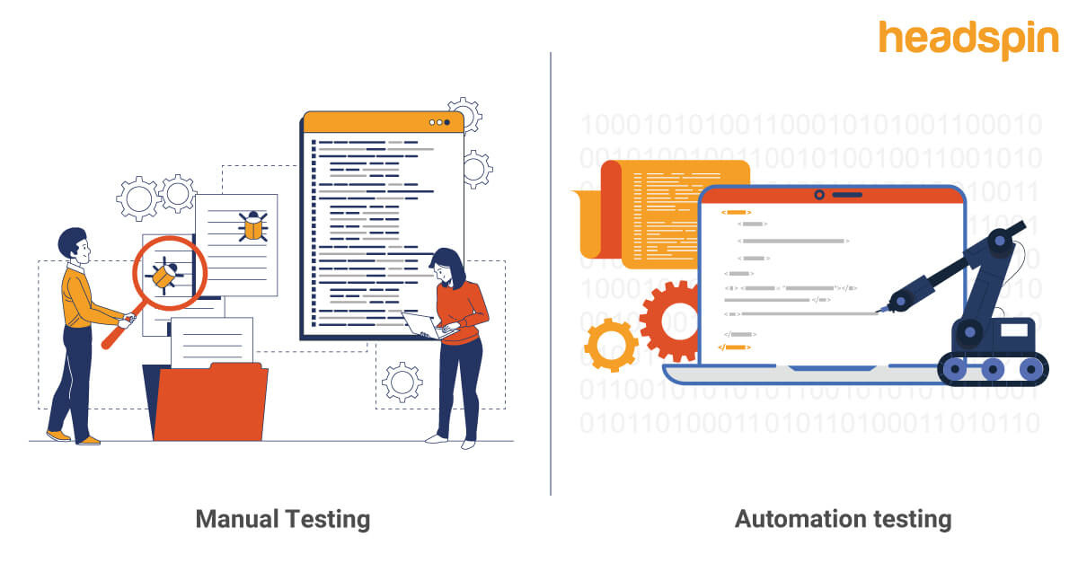
Manual Testing VS
Automation Testing
Automation Testing
Uses tools/scripts to run tests automatically
Faster and more efficient for repeated tests
Best for regression and large projects
Requires initial setup and programming skills
Manual testing discovers the issues. Automation testing speeds up finding them again. Both are needed for a complete testing strategy.
Manual Testing
Tester executes all steps manually
Useful for UI/UX issues
Best for new features & exploratory testing
Requires human judgment and experience
Egypt Digital Pioneers Initiative

Slide 9

What is Automation
Automation saves a huge amount of time and effort by running tests much faster and as many times as needed, without the limits of manual testing
in Software Testing
Automation in software testing is the process of using tools and scripts to execute test cases automatically instead of performing them manually.
It helps testers run tests faster, more accurately, and more consistently. Common tools include Selenium and TestNG.
Next Step
Egypt Digital Pioneers Initiative

Slide 10



Importance of Automation Testing
Speeds up the testing process by running repetitive tests automatically
Improves accuracy by reducing human error in test execution
Allows running tests frequently, which supports better software quality
Helps cover more scenarios and increases overall test coverage
Automation saves a huge amount of time and effort by running tests much faster and as many times as needed, without the limits of manual testing
Egypt Digital Pioneers Initiative

Slide 11

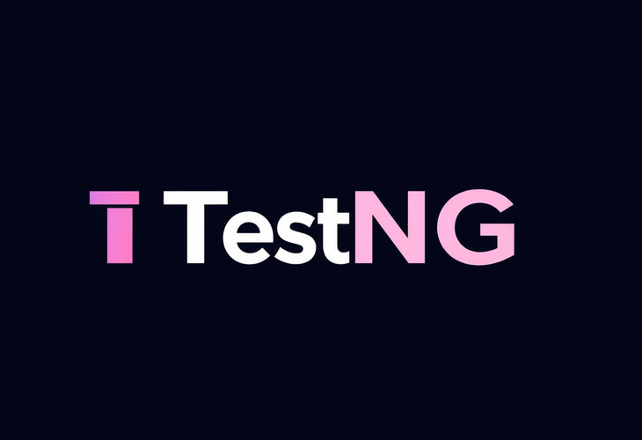
What is an Automation Framework
A framework is a ready-made and organized system that we build to help us write automation tests easily, consistently, and without repetition.
It consists of rules, tools, and a structured design that makes automation work easier, faster, and cleaner.
Next Slide
Egypt Digital Pioneers Initiative

Slide 12
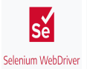
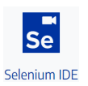
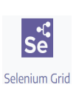
Selenium
What is Selenium?
* Selenium is a powerful tool used for web automation testing.
* It controls the browser to perform actions like click, type, scroll, and read elementstetur
Why Companies Use Selenium?
* Free and open-source.
* Works on all major browsers.
* Fast, flexible, and widely used in companies.
* Perfect for testing large and complex web applications.
Egypt Digital Pioneers Initiative

Slide 13
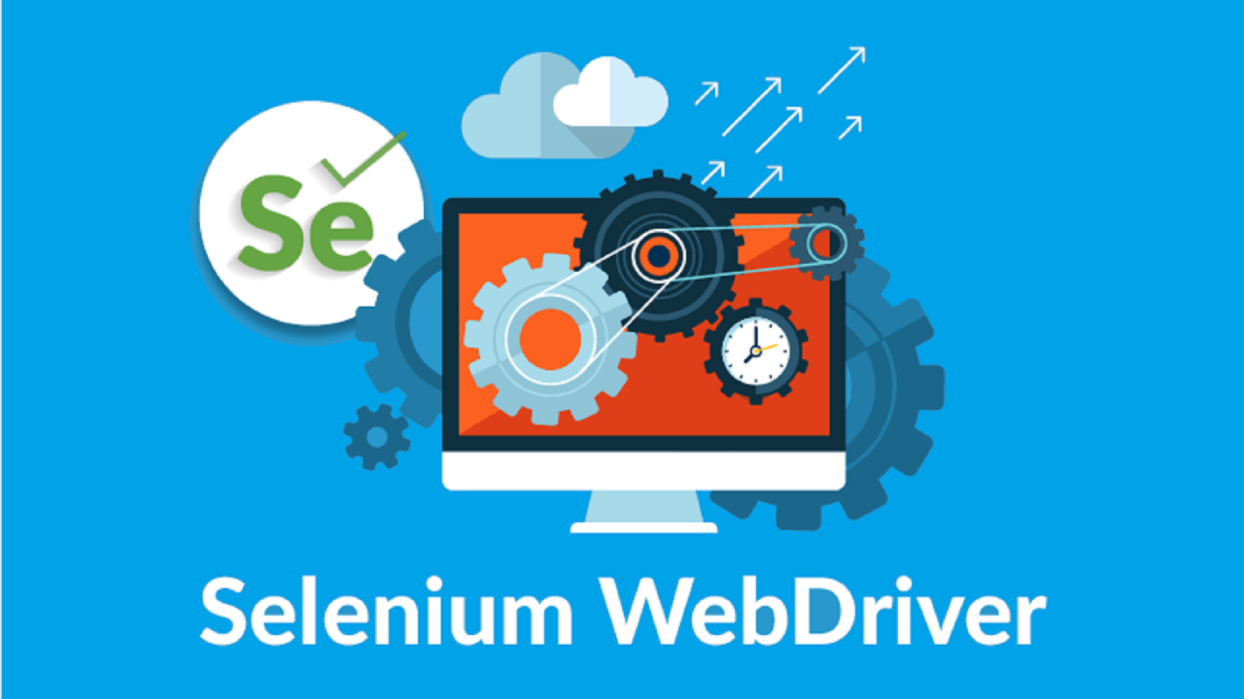
Selenium WebDriver
Selenium WebDriver
Selenium WebDriver is like a taxi driver who can drive your browser… even without seeing the road!
Selenium WebDriver lets you control the browser through code, performing actions and checks like a real user
Locators in Selenium
Locators are techniques used to identify and interact with elements on a webpage, such as:
ID, XPath, CSS Selector, Name, ClassName, TagName, LinkText.
Common WebDriver Actions
Actions = all interactions performed by the WebDriver on UI elements.
Common actions include: click(), sendKeys(), getText(), clear(), submit(), isDisplayed(), etc
Egypt Digital Pioneers Initiative

Slide 14
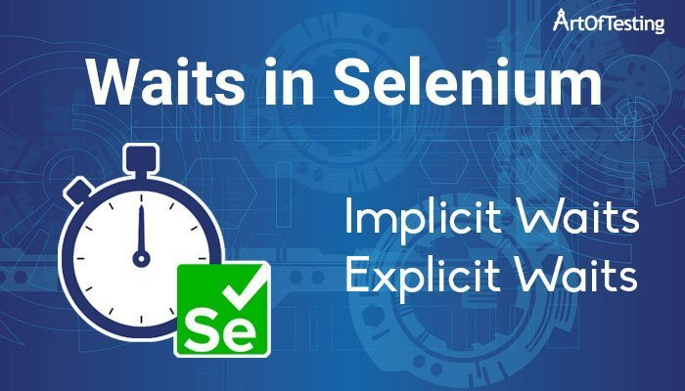
Waits in Selenium
Selenium WebDriver
If the website is dynamic and keeps changing IDs,
WebDriver acts like a driver who uses landmarks instead of street names
Waits ensure stability by waiting until elements become interactable.
such as :
1-mplicit Wait.
2-Explicit Wait.
Selenium with TestNG & Maven
TestNG: Provides test execution control, assertions, grouping, and reporting.
Maven: Manages project dependencies and build lifecycle.
Egypt Digital Pioneers Initiative

Slide 15

What is TestNG?
TestNG is a testing framework designed for Java automation
Helps you organize, group, and control your tests easily.
It’s inspired by JUnit but more powerful and flexible.
Main Features of TestNG
Why TestNG?
Annotations:
Makes tests structured and readable.
Before TestNG, testers used to run test scripts inside a main() method:
Hard to manage multiple tests.
Important ones:
@Test
@BeforeMethod / @AfterMethod
@BeforeClass / @AfterClass
@BeforeSuite / @AfterSuite
No automatic setup/teardown.
No parallel execution.
No annotations.
No reporting.
So TestNG was introduced to solve all these problems and give a structured way to run automated tests.
Egypt Digital Pioneers Initiative

Slide 16
What Are Assertions?
Assertions are essential for verifying expected vs. actual results, ensuring test accuracy, stopping invalid tests, and maintaining the quality and reliability of the automation framework.
Hard Assertions
Hard Assertion stops the test execution immediately when a verification fails
What Are Assertions?
Validating text, URLs, titles, and page elements.
Verifying visibility or state of UI elements.
Confirming calculations, logic outputs, or returned values.
Ensuring workflows behave as intended.
Soft Assertions
Types of Assertions?
Soft Assertion allows the test to continue even if one or more assertions fail
AssertFalse(condition).
AssertTrue(condition).
AssertEquals(actual, expected).
AssertNotEquals(actual, expected).
Egypt Digital Pioneers Initiative

Slide 17
What is the TestNG
01
XML file?
Why is it Important?
Controls test execution without changing code
The TestNG XML file is a configuration file that allows you to organize, control, and manage how your test cases are executed.
It defines which classes, packages, or groups to run and in what order
Allows grouping and selecting specific tests
Supports parallel execution
Enables parameter passing
Essential for building a complete test framework
02
What You Can Do with testng.xml ?
Run all tests in a project
Run tests inside specific packages or classes
Run only certain groups (e.g., "Smoke", "Regression")
Set execution priority and order
Run tests in parallel (methods, classes, suites)
Egypt Digital Pioneers Initiative

Slide 18
What is Maven?
Why is Maven Important?
Maven is a build automation and dependency management tool used mainly in Java projects.
It helps developers and testers manage libraries, build projects, run tests, and maintain consistent project structure.
Automatically downloads required libraries (dependencies).
EAllows running tests through command line or CI/CD tools.
Integrates smoothly with frameworks like Selenium, TestNG, JUnit
Key Features of Mave .
What is pom.xml?
Dependency Management
The Project Object Model (pom.xml) is the heart of Maven.
It controls everything in the project:
POM File (pom.xml)
Build Automation
Standard Project Structure
Integration with CI/CD
Egypt Digital Pioneers Initiative

Slide 19
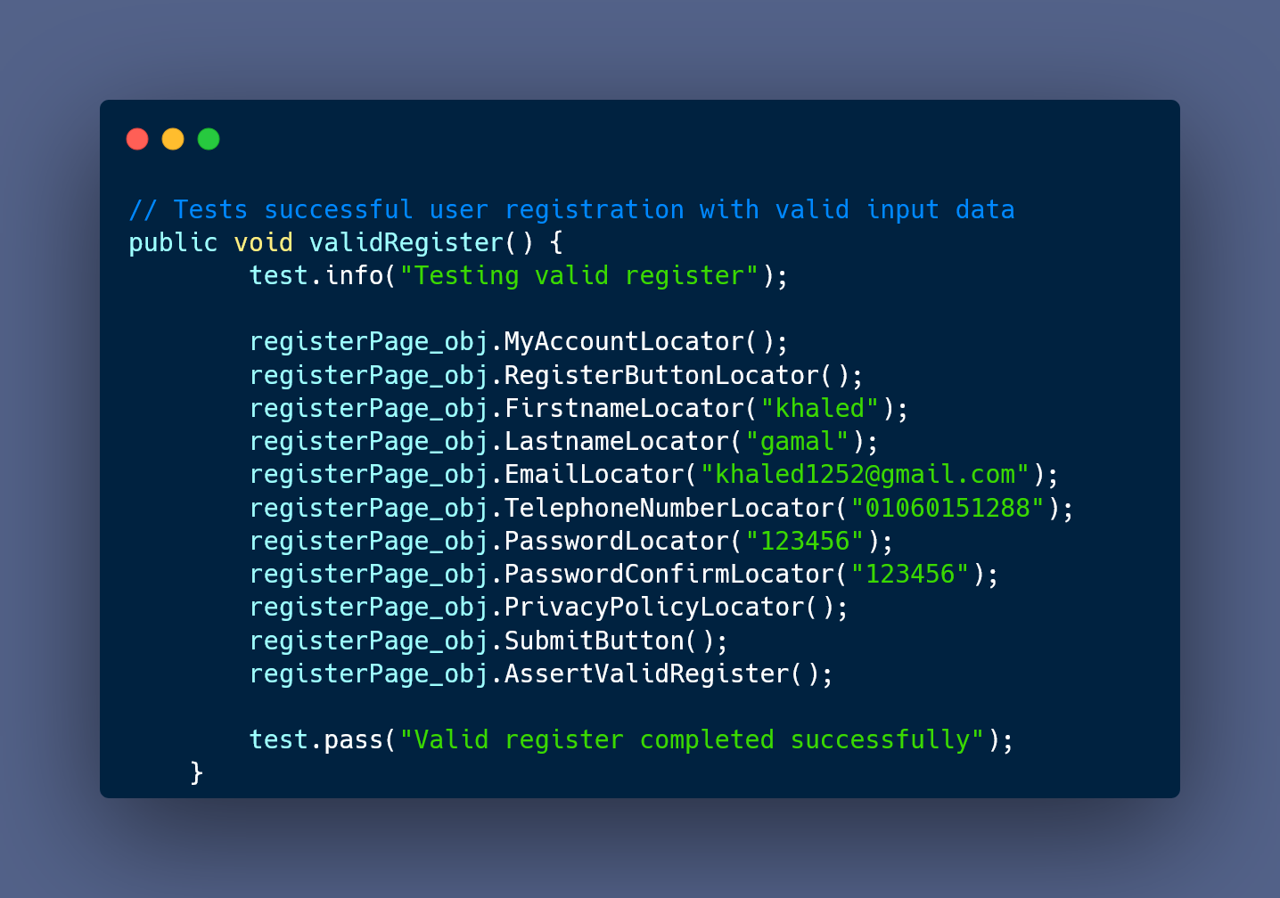
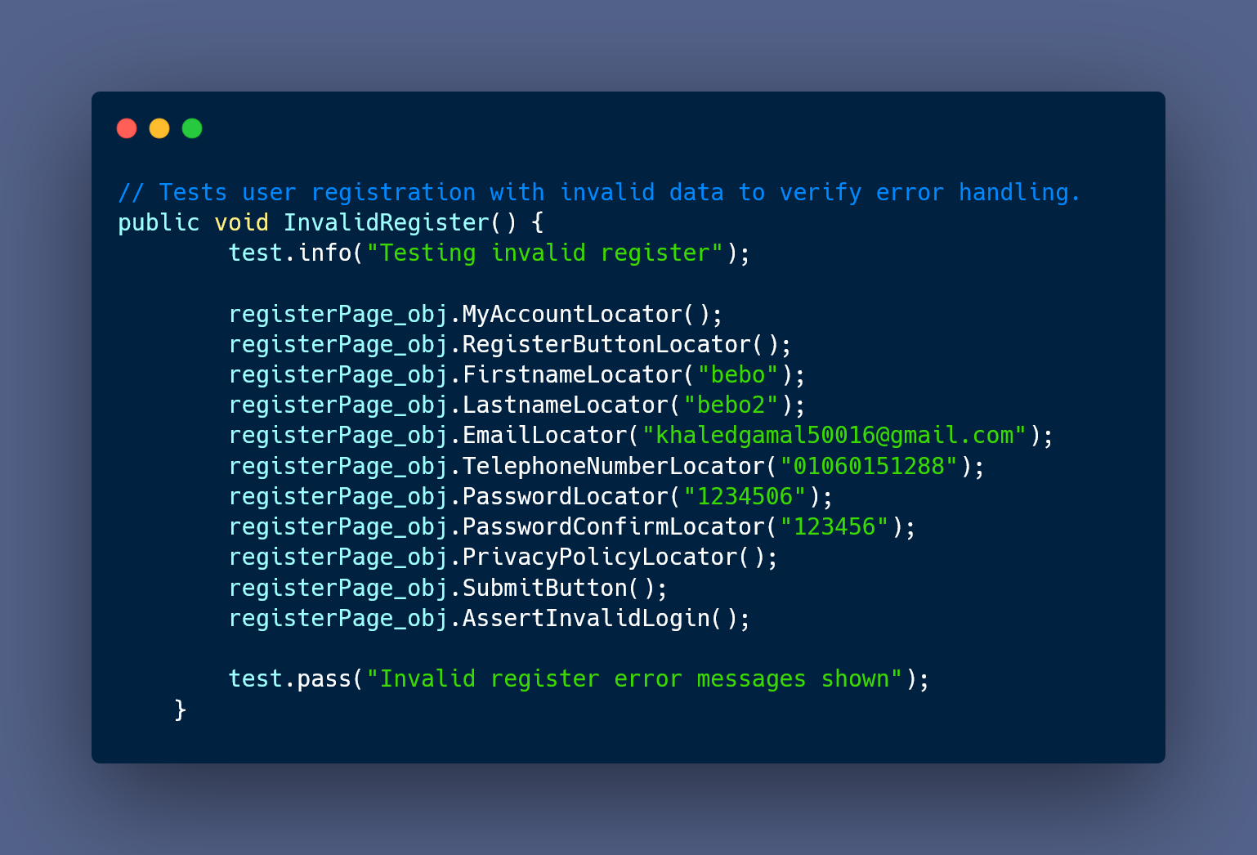
Scripts
Egypt Digital Pioneers Initiative

Slide 20
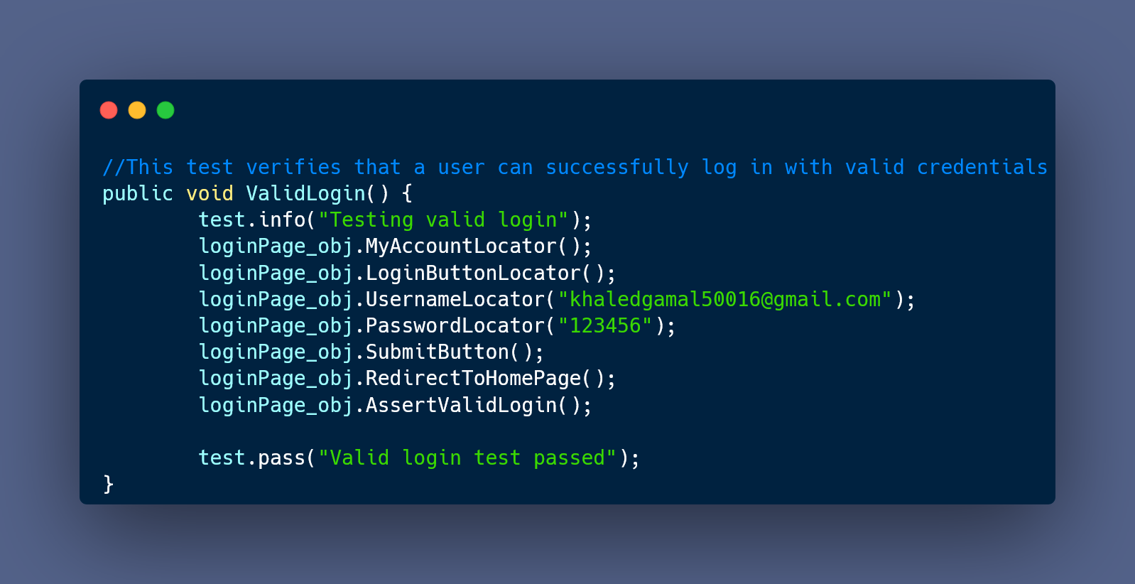
Scripts
Egypt Digital Pioneers Initiative

Slide 21
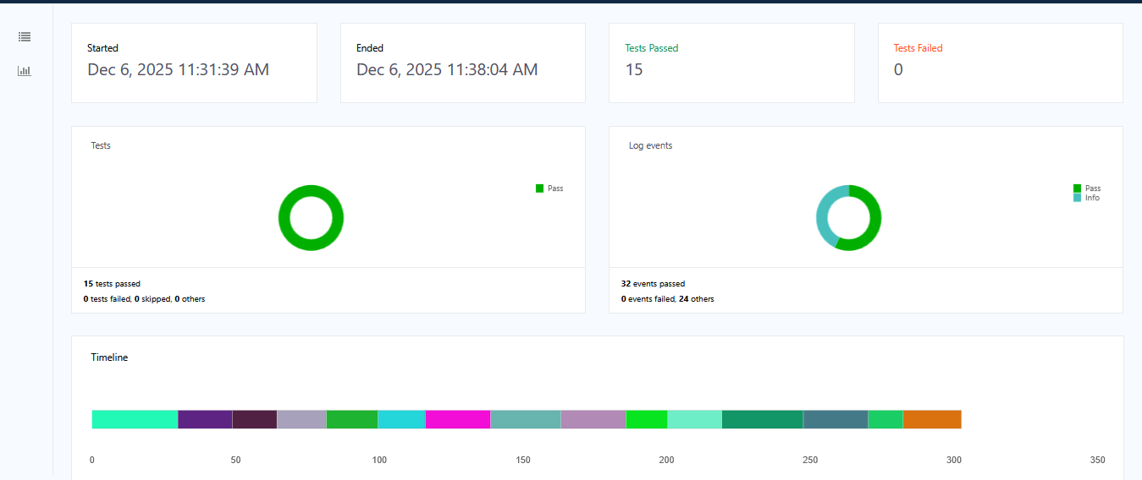
Extent report .
Egypt Digital Pioneers Initiative

Slide 22
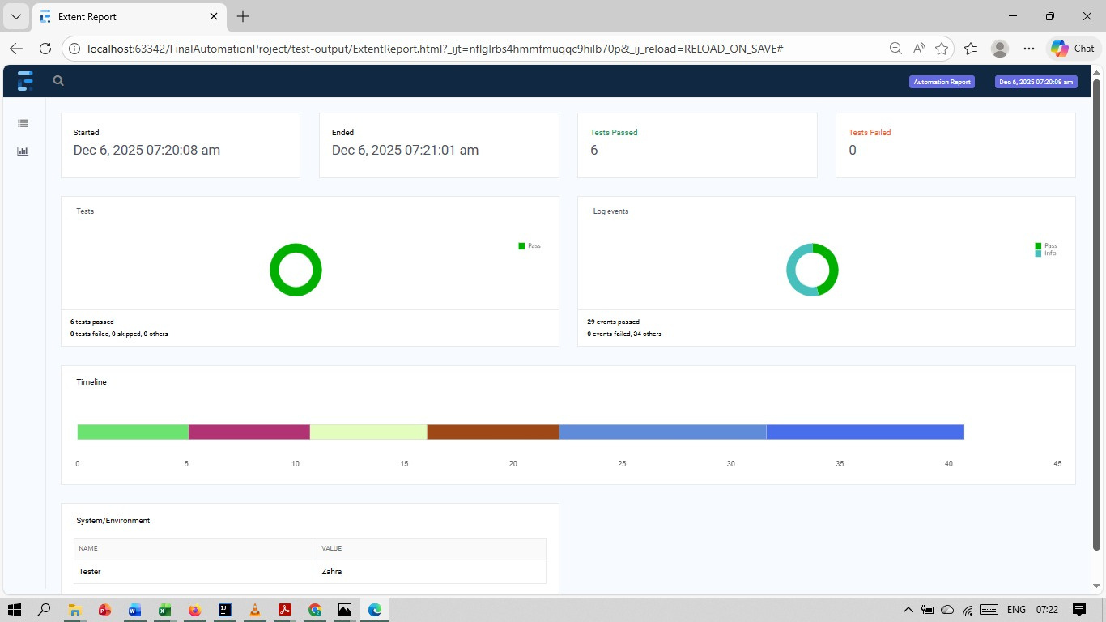
Extent report .
Egypt Digital Pioneers Initiative

Slide 23
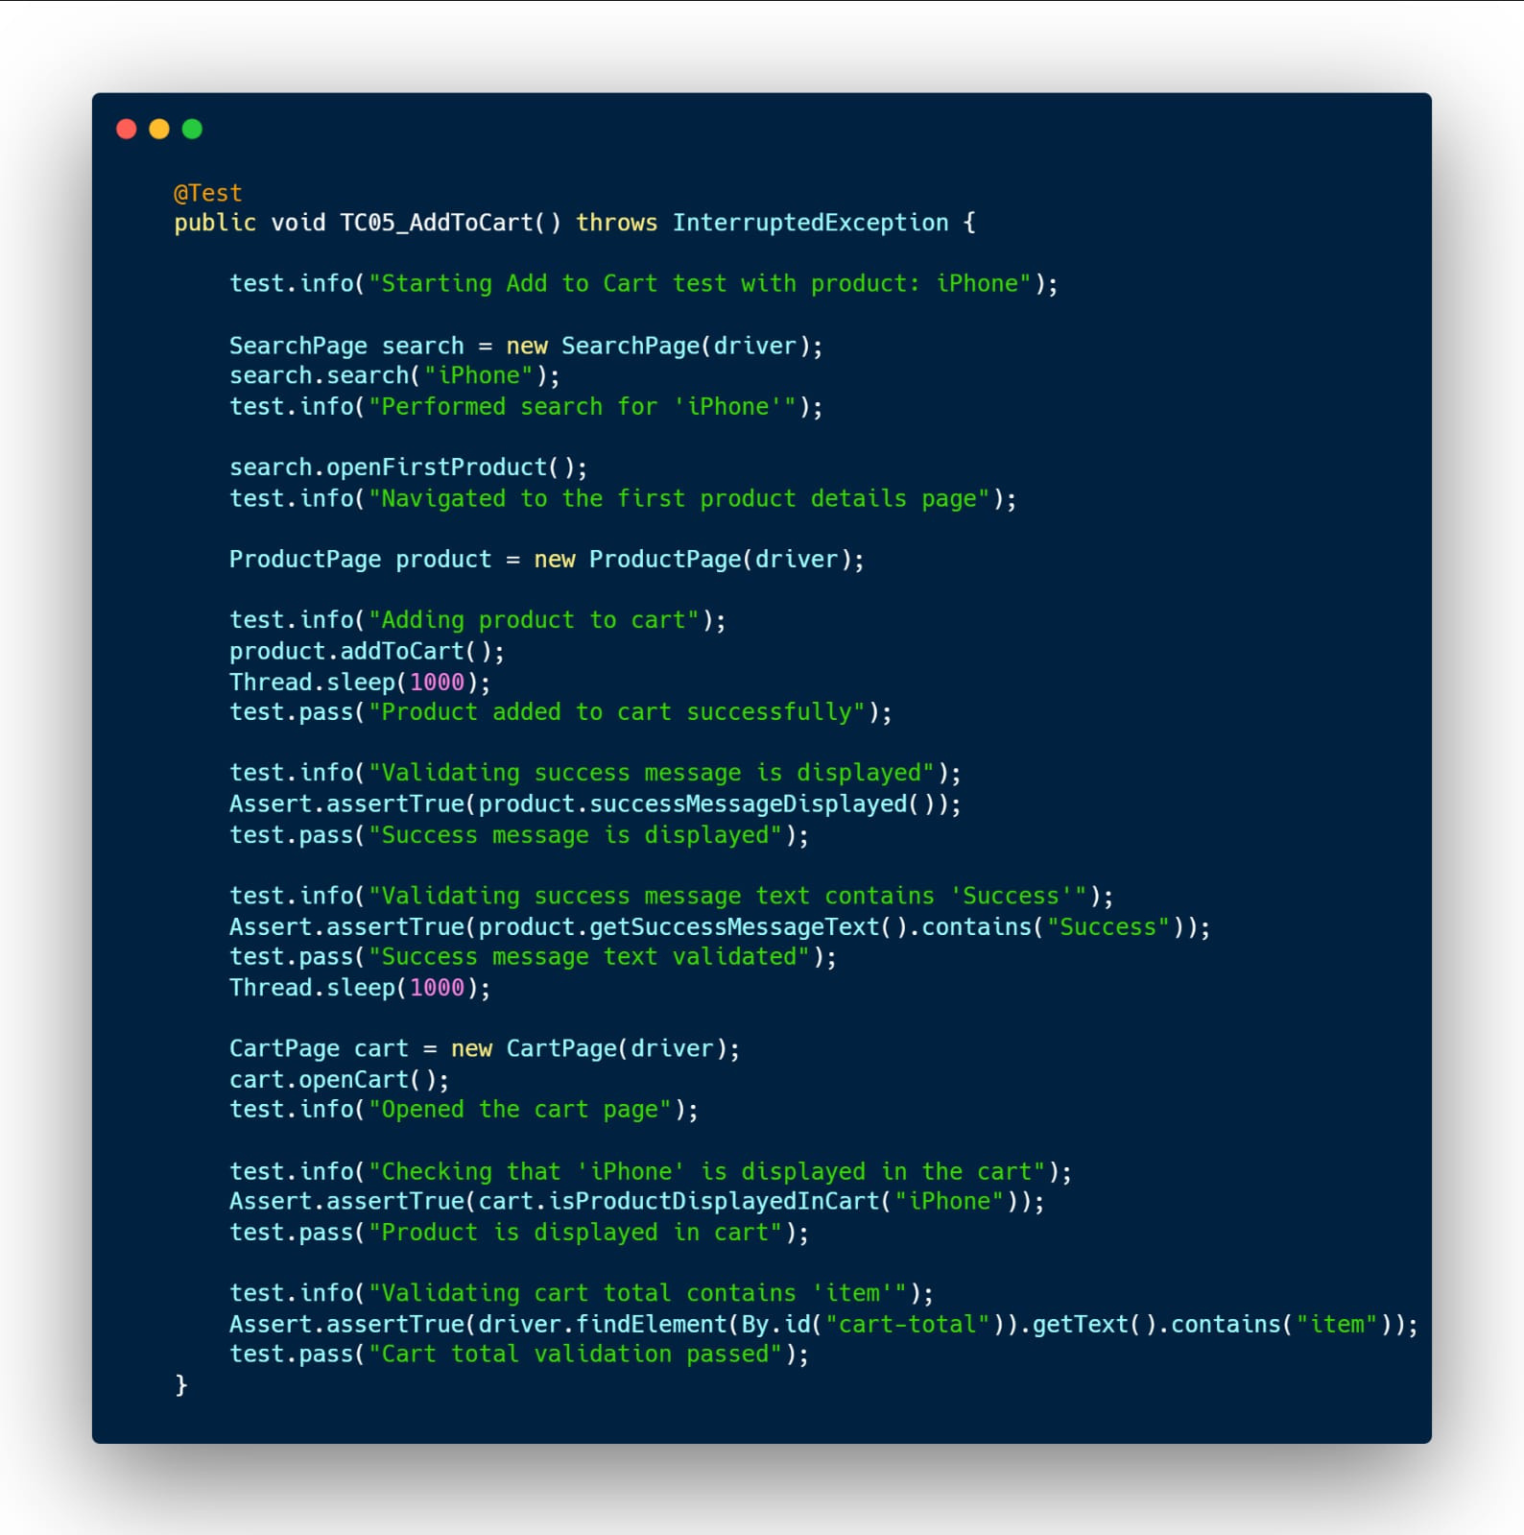
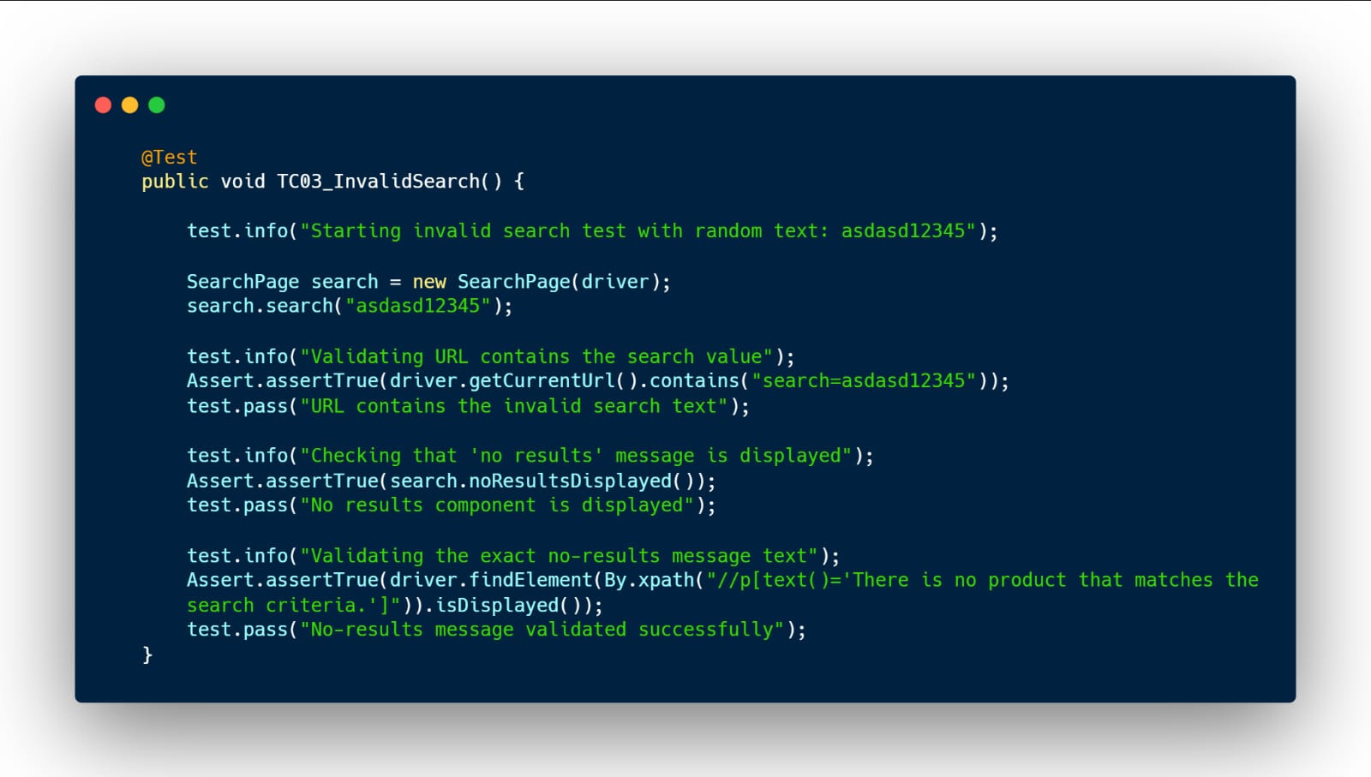
Scripts
Egypt Digital Pioneers Initiative

Slide 24
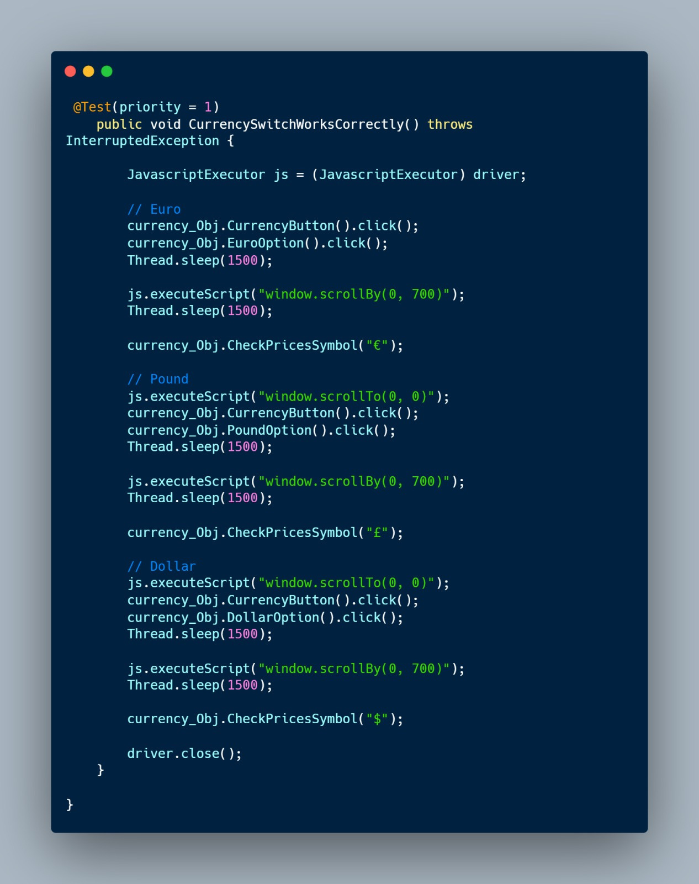
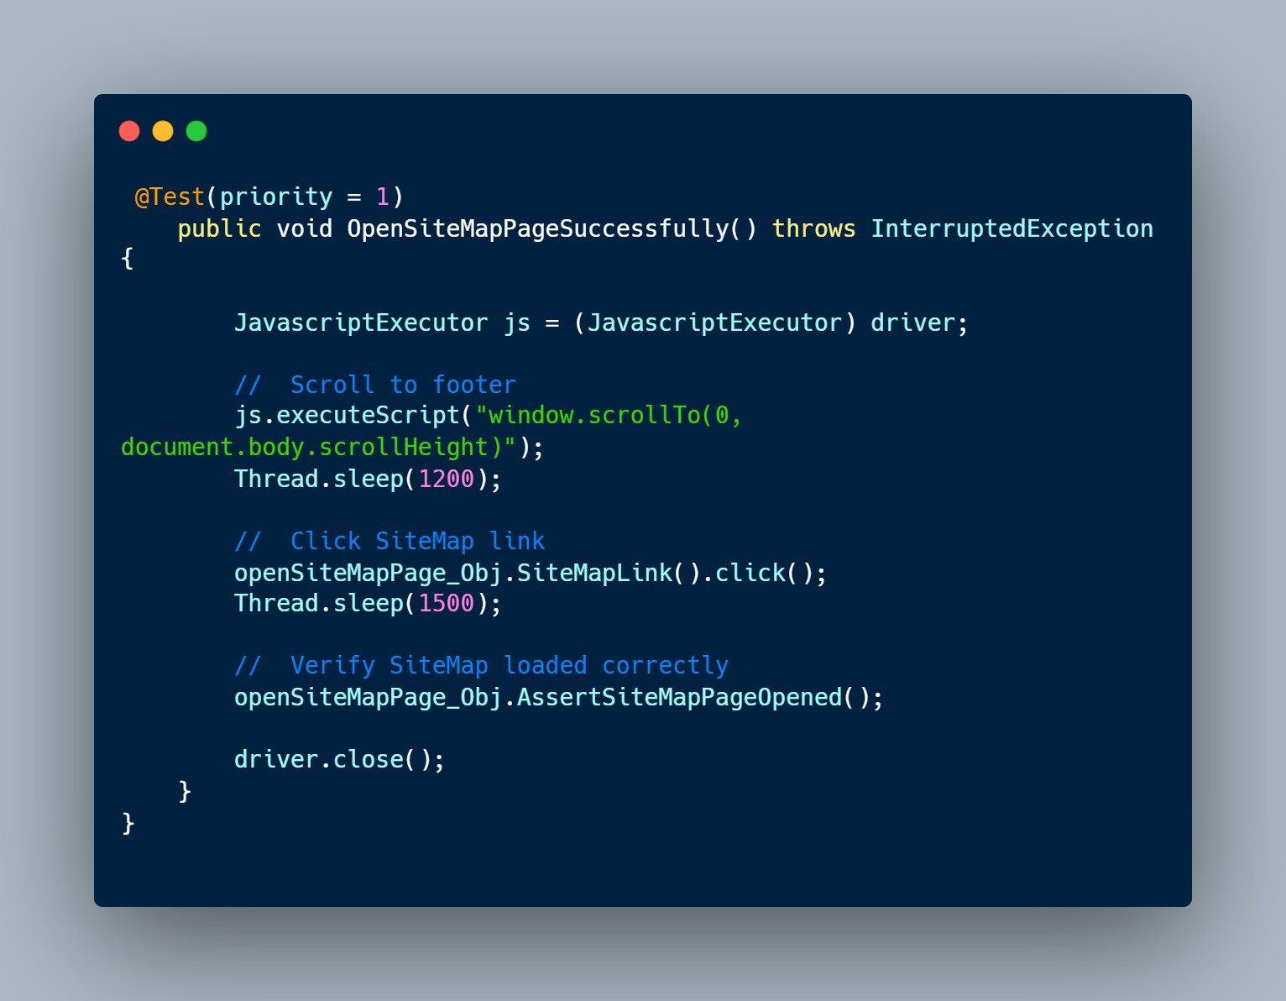
Scripts
Egypt Digital Pioneers Initiative

Slide 25
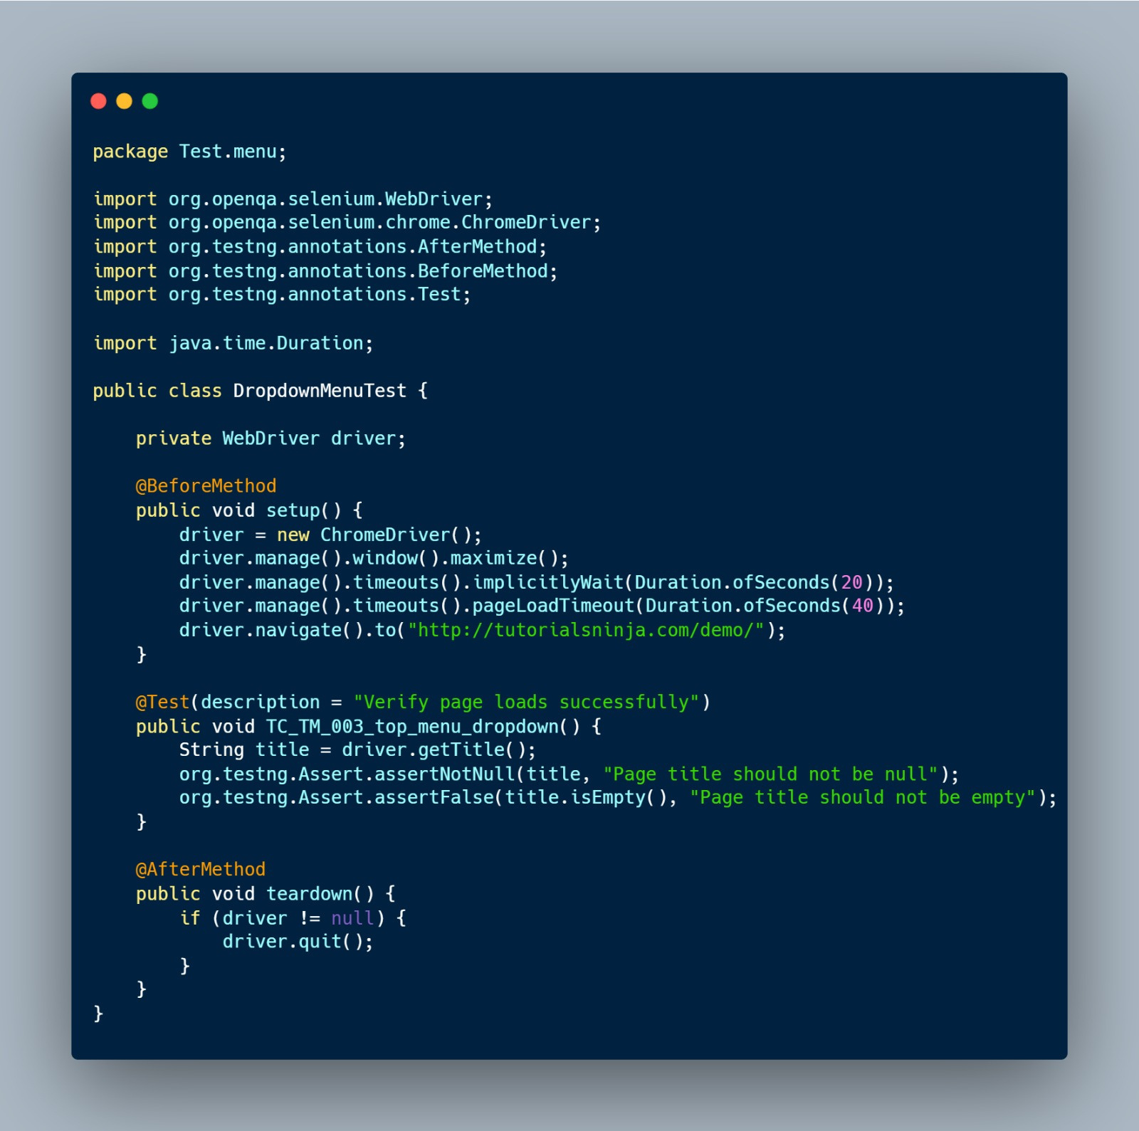
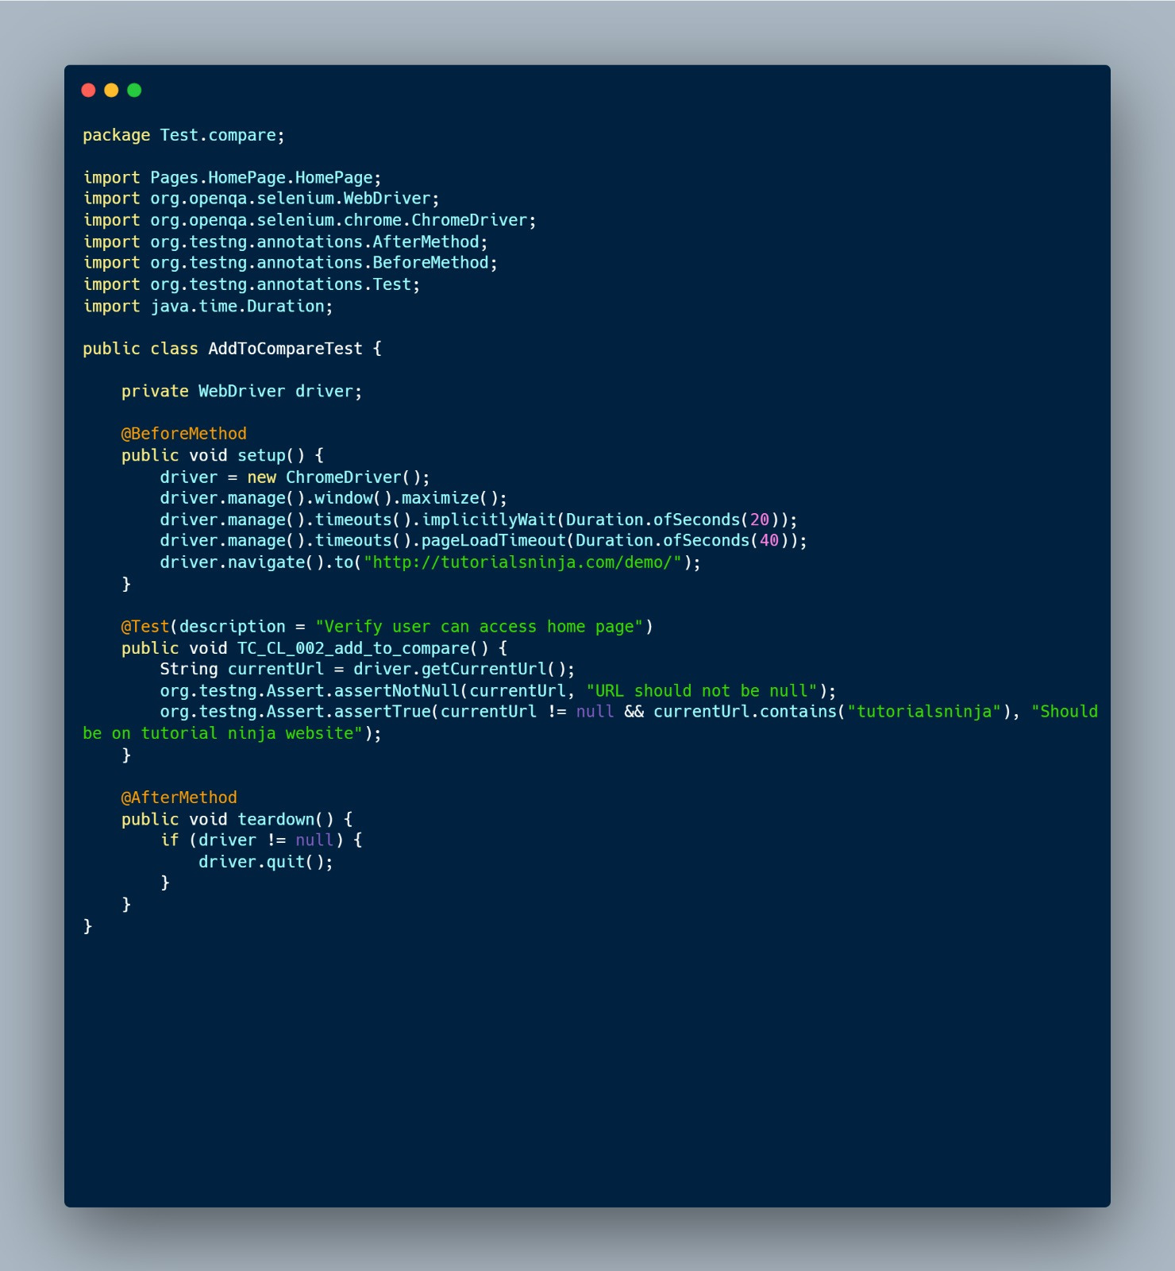
Scripts
Egypt Digital Pioneers Initiative

Slide 26

About Us
Contact
Home
THANK YOU
Egypt Digital Pioneers Initiative

